Slide 1
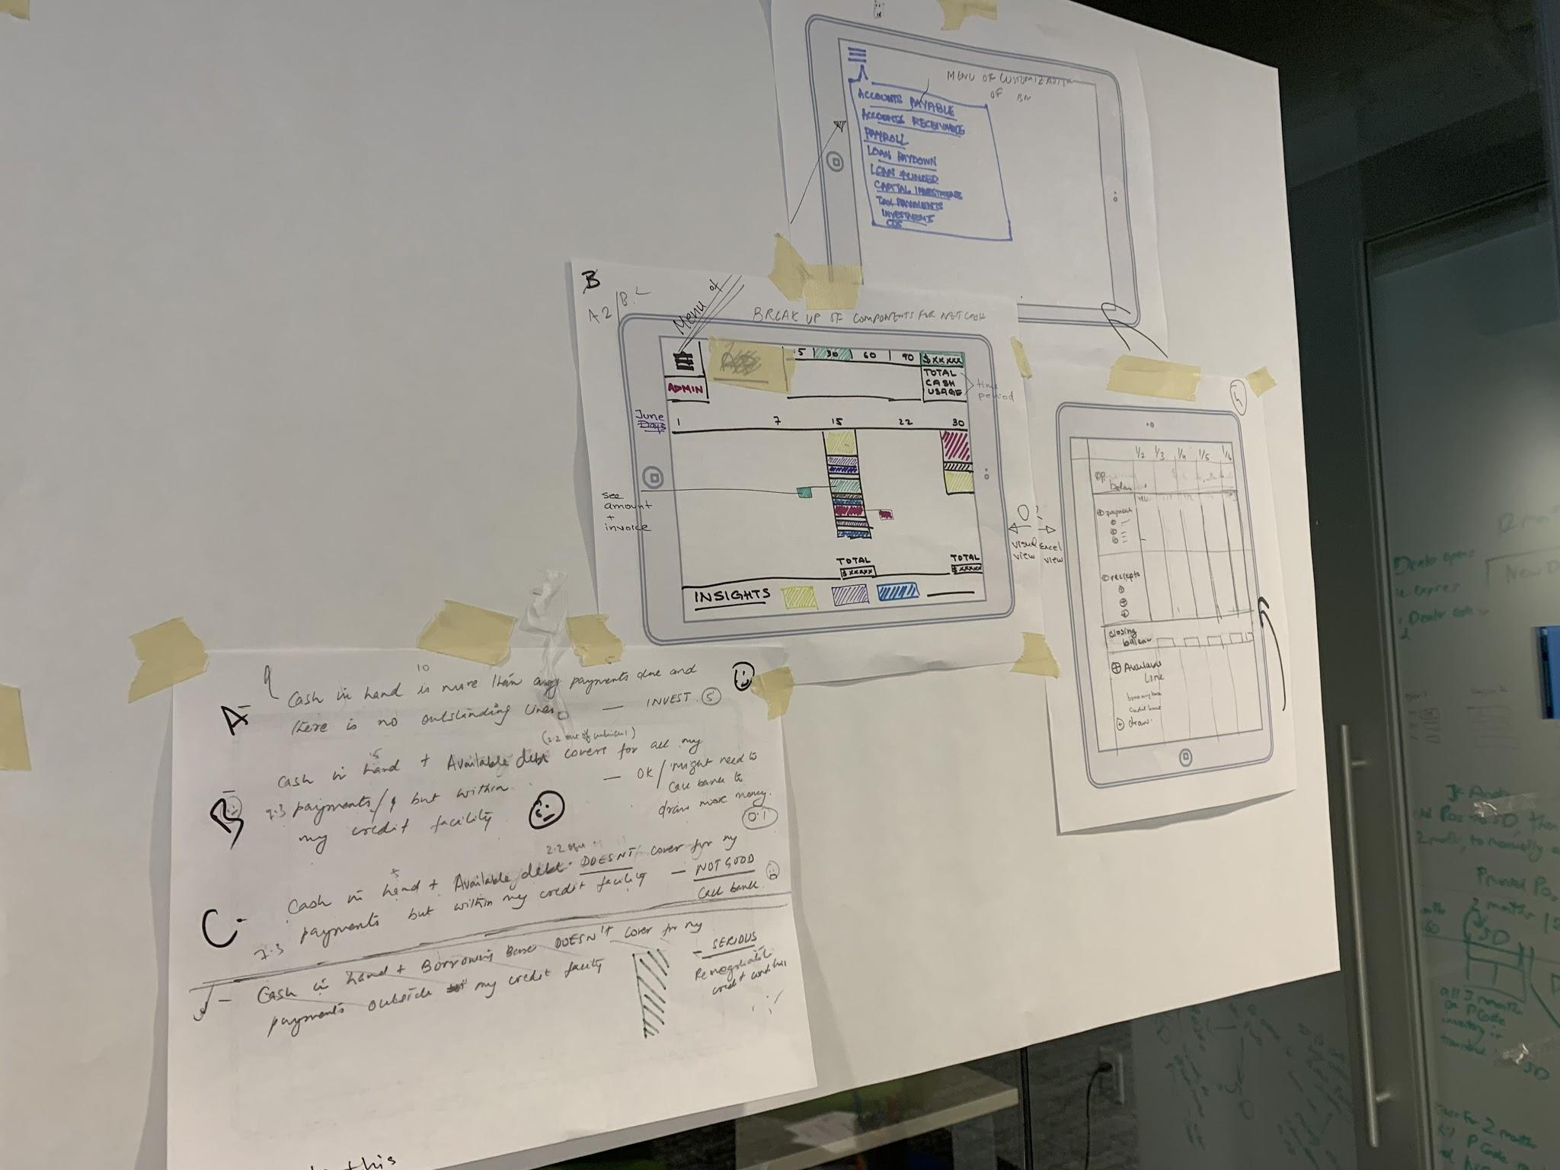

Girl Develop It!
Design Critique and Storytelling Pt. 2

Slide 2

Welcome!
^ PT 2

Slide 3


MEET YOUR INSTRUCTOR
Rahel Campbell
Senior UX Designer @ Infosys/Wongdoody
3.5 years Experience

Slide 4
01
TODAY’S AGENDA
Recap
Design Critique and Storytelling; the why
Presentations
Individual presentations (storytelling) followed by peer feedback (critique)
Resources
Recommended resources for continued education
Design Critique and Storytelling Pt. 2

Slide 5

02
Recap
Design Critique and Storytelling Pt. 2

Slide 6

THE WHAT?
What is a Design Critique?
A design critique is performed in order to evaluate a design and provide feedback on whether or not it meets business objectives and user needs.
Design critiques encourage collaboration within teams and provide a boost to positive team culture toward improving design ideas.
The feedback received during design critiques helps designers think outside of the box, often leading to better, more innovative choices throughout the design process.
Conducting a productive design critique session can be challenging. Designers often forget that not everyone understands the finer points of the design process, the language of design criticism, and the rules of a design critique.

Slide 7

THE WHY?
Why Conduct a Design Critique?
It is nearly impossible to improve a design without feedback from others. Their input helps you avoid mistakes and thus create higher quality work.
The old saying rings true: two brains (or more in this case) are always better than one.

Slide 8

WHAT?
What is Storytelling?
Storytelling is a method of delivering highly retainable information through immersion, allowing us to have an experience without experiencing something directly ourselves.
Much of this is due to the fact that our brains are hardwired for story. We naturally process the past and the present through narrative based memories.
Storytelling is a communication tool used throughout all cultures, starting with the advent of campfires and stone tools, where we first used stories to exchange information in order to warn, teach, and inspire within our earliest communities.
When do you use storytelling? Can you think of time storytelling made a difference for you?

Slide 9

WHY?
Why Conduct Storytelling?
Designers create personas to represent target users and add conflict to stories that reflect their user journeys and problems. Crafting stories, designers can better understand what users want from a solution.
What’s the essential thing you are trying to convey to your audience? When you walk into a client meeting, what do you want them to take away the most? You aren’t selling them on a website, or a branding campaign. You’re selling them on a story, an idea, a dream.
Your client dreams of something bigger than just “website” or “brand.” They dream of loyal customers who say glowing things about them. They dream of changing the world through the work they do. They dream of some story that, as the designer, it’s your job to uncover.

Slide 10
03
Presentations
Design Critique and Storytelling Pt. 2

Slide 11

NEXT STEPS
Here’s what we’re asking students to present:
Brief introduction to problem statement
An overview of your insights
An overview of your solutions
1-2 examples of lessons learned
1-2 examples of recommended next steps

Slide 12

NEXT STEPS
Logistics:
Each student will have ~5 minutes to present to the class. Presentations are not required but strongly encouraged to receive the benefits of practicing design and critique
Present with 5-7 slides in a format of your choice (Google Slides, PowerPoint, Keynote, etc.) and be prepared to screenshare
As each student is presenting, we ask that others take notes of effective feedback per student/presentation and be ready to share
Remember - this is a safe space!

Slide 13

NEXT STEPS
Let’s go!
Here are some topics to consider when conducting design critique:
What is the problem statement?
Who is the intended audience member(s)?
What are the main concerns the design solution should address?
What’s the rationale behind the design solution?

Slide 14

NEXT STEPS
Let’s pause and reflect
What did you enjoy about this exercise?
Any improvements?
What would you do differently, if anything?
Will you try this again in the future?

Slide 15
03
Resources
Design Critique and Storytelling Pt. 2

Slide 16
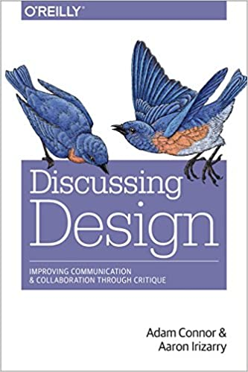
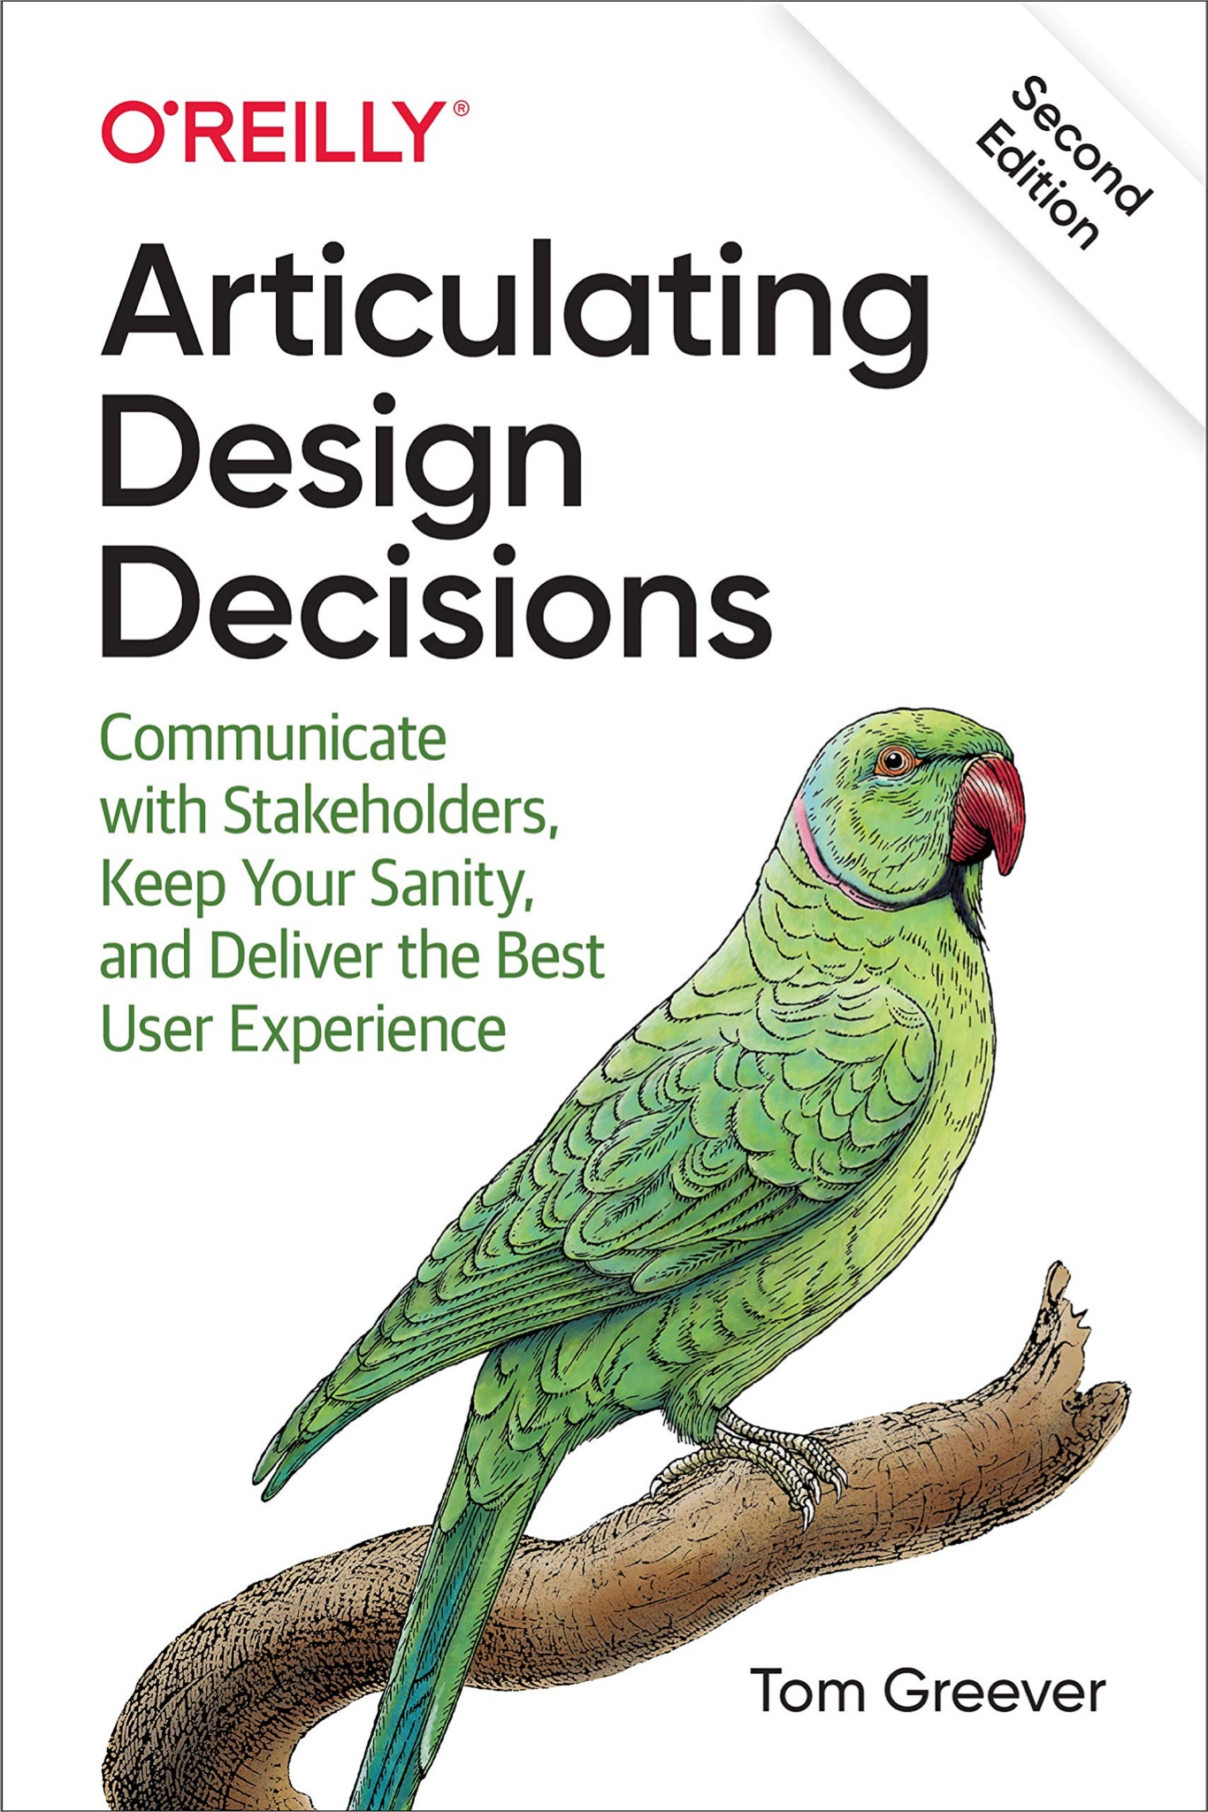
NEXT STEPS

Slide 17
NEXT STEPS
Link:
"Cultural Competencies & The Art and Design Critique" LibGuide by Micki Harrington, Lesley University Library
"Thinking About Studio Critique" by Adelheid Mers, The School of the Art Institute of Chicago
"Ten Ideas for More Effective Critiquing" by Mario Estioko, John P. Forrest, Jr., Gwen Amos, Sacramento State University
"Pure Craft" Is a Lie (Part 1)" by Matthew Salesses, Pleiades: Literature in Context
"A Case for Workshop Alternatives" by Karen Craigo, Whale Road Review: A Journal of Poetry & Short Prose
How to deal with criticism when people hate your designs https://www.fastcompany.com/90650702/how-to-deal-with-criticism-when-people-hate-your-designs

Slide 18

THANK YOU
Any Questions?
What did you learn new today?
Let’s keep in touch:

